Slide 1
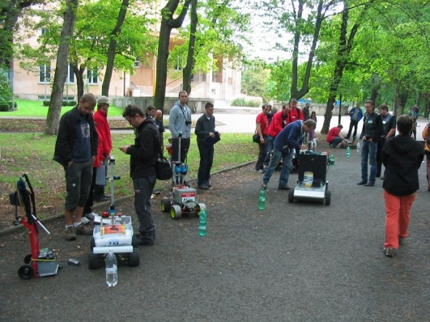
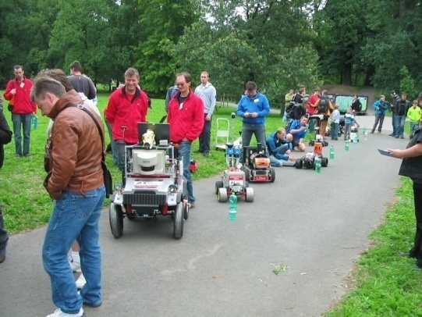
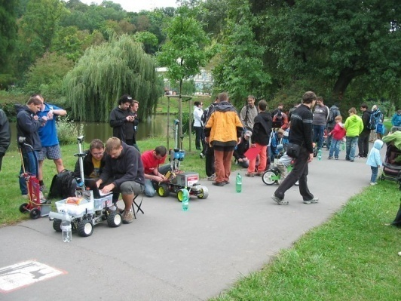
Robotour 2012 – robotika.cz outdoor delivery challenge
Praha/Stromovka 15.9.2012

Slide 2
Overview
12 registered teams, 11 arrived, 10 homologated, 6 scoring
New teams: The Experts, [FAIL], Plecharts, Siners + new Cogito robot
3 runs/kola: 596m, 249m, 663m
Weather --- good ☺ (7th year already)

Slide 3
OSM maps
Recently changed license – some segments were deleted
Necesary to properly handle tags highway=steps, highway=track, barrier=*
Old/new map snapshots
Teams edit the maps (delete segments)
Ads – MapFactor Android Navigator

Slide 4
Rules (1/2)
Blocking rule was not used … 3rd run Roboauto Karlík vs. Cogito
Unreliable score … last position of Karlík under tree +/- 5m & “random” walk of Short Circuits and exact timeout
Emergency STOP -> disqualified if not emergency
No need of fully blocked road

Slide 5
Rules (2/2)
Easily removable payload … next year some with and some without payload?
Payload deployment? (at the goal position & return to the base)
3 or 4 runs?
Far away starts/goals?

Slide 6
Robotour 2013
Poland/Lodz, 28/9/2013 (with RiE 26-27/9)

Slide 7
Thank you for coming & playing with us
robotika.cz

